Slide 1
Understanding .NET Standard
Jason Bock

Slide 2
Personal Info
http://www.jasonbock.net
https://www.twitter.com/jasonbock
https://www.github.com/jasonbock
jason.r.bock@outlook.com

Slide 3
Downloads
https://github.com/JasonBock/Presentations/blob/master/
Understanding%20.NET%20Standard.pptx
https://github.com/JasonBock/UnderstandingNETStandard

Slide 4
Overview
History
Definitions
Recommendations
Remember….
https://github.com/JasonBock/Presentations/blob/master/
Understanding%20.NET%20Standard.pptx
https://github.com/JasonBock/UnderstandingNETStandard

Slide 5

History
http://cdn5.windowswally.com/wp-content/uploads/2014/09/NET-Framework-3.5-in-Windows-8-Featured-Windows-Wally-300x300.png
Notes:
In the beginning….was the .NET Framework. It was the “one runtime to rule all languages”, or something like that.

Slide 6

History
https://luauf.com/wp-content/uploads/2008/05/mono-logo.png
Notes:
There was also Mono, which was an open source implementation. The vast majority of .NET developers didn’t target this, but it was another option, and it let devs target other OSes.

Slide 7

History
https://www.wired.com/wp-content/uploads/2010/09/Microsoft_Silverlight.jpg
Notes:
At some point, Silverlight came into being, letting .NET devs target the browser but staying completely within .NET. And the world started to get complicated.

Slide 8

History
https://www.xamarin.com/content/images/pages/branding/assets/xamagon.png
Notes:
Then, Xamarin came forth, letting .NET devs target mobile platforms, and the icons got smaller.

Slide 9


History
https://cdn0.froala.com/assets/editor/docs/server/meta-social/dotnet-core-12b6094aae01e933196c60b4e87181bf.png
Notes:
And don’t forget .NET Core!

Slide 10
History
.NET – 1.0, 1.1, 2.0, 3.0, 3.5, 4, 4.5, 4.5.1, 4.5.2, 4.6, 4.6.1, 4.6.2, 4.7, 4.7.1
Mono – 1.0, 1.1, 1.2, 2.0, 2.2, 2.4, 2.6, 2.8, 2.10, 3.0, 3.2, 3.4, 3.6, 3.8, 3.10, 3.12, 4.0, 5.0, 5.2, 5.4
Silverlight – 1, 2, 3, 4, 5 (all with numerous point releases)
Xamarin – I won’t even try
.NET Core – 1.0, 1.1, 2.0
https://docs.microsoft.com/en-us/dotnet/framework/migration-guide/versions-and-dependencies
https://en.wikipedia.org/wiki/Mono_%28software%29
https://www.microsoft.com/getsilverlight/locale/en-us/html/Microsoft%20Silverlight%20Release%20History.htm
https://developer.xamarin.com/releases/
https://github.com/dotnet/core/blob/master/release-notes/download-archive.md
Notes:
The number of versions they’ve produced is staggering.

Slide 11

History
https://tctechcrunch2011.files.wordpress.com/2015/01/shared.jpg?w=738
Notes:
How do you share code between them?

Slide 12

History
Portable Class Library
https://img.buzzfeed.com/buzzfeed-static/static/2015-03/31/1/enhanced/webdr02/enhanced-7879-1427781273-1.jpg
Notes:
There was an attempt to address this with Portable Class Libraries, or PCLs (“pickles”)

Slide 13
History
.NET Framework 4.0
Silverlight 5.0
Profile14
Notes:
A profile is an intersection between two different versions. For example, Profile14 exists for .NET Framework 4.0 and Silverlight 5.0

Slide 14
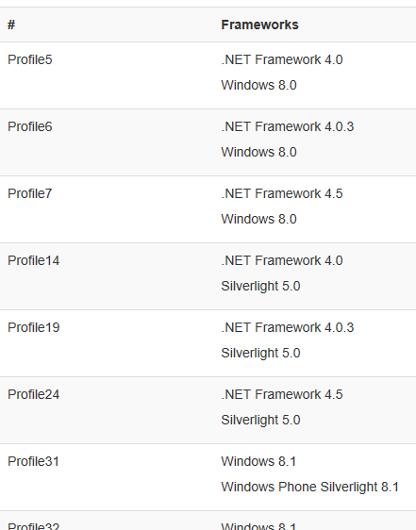
History
https://portablelibraryprofiles.stephencleary.com/
Notes:
But as you can imagine, trying to manage all these intersections gets extremely unwieldy.

Slide 15
History
http://www.reactiongifs.com/r/absurd.gif
Notes:
Yes, this IS absurd!

Slide 16
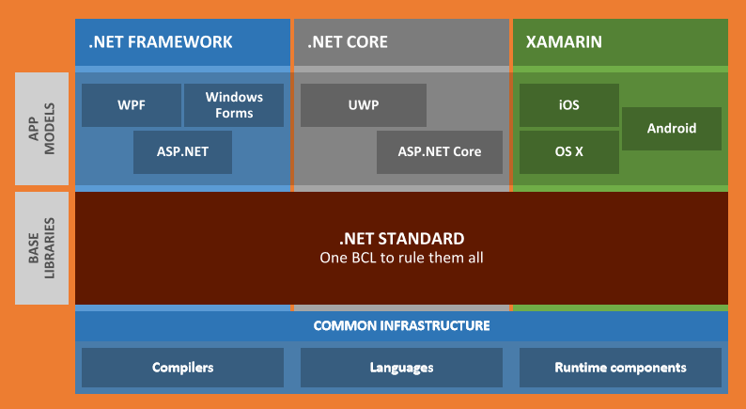
Definitions
https://www.slideshare.net/terrajobst/net-standard-introduction
Notes:
.NET Standard is different. It’s a specification that all .NET platforms must implement.

Slide 17

Definitions
https://www.slideshare.net/terrajobst/net-standard-introduction
Notes:
It builds upon previous versions. So, if your library targets NS 1.0, it will work in 2.0, guaranteed.

Slide 18
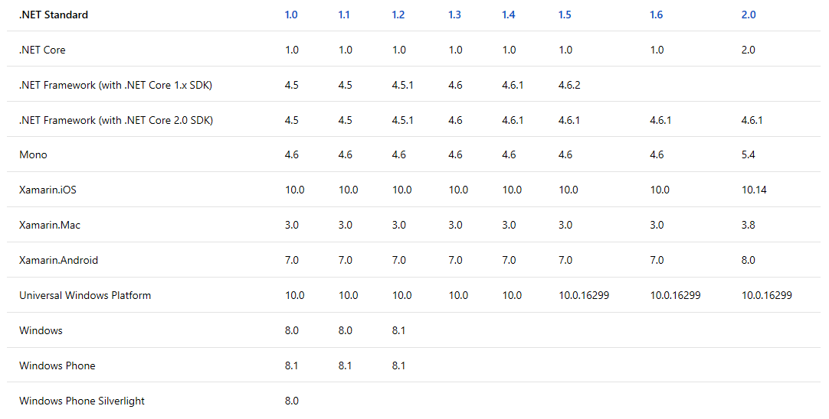
Definitions
Notes:
While this chart may look confusing at first glance, it’s pretty easy to see which platforms support what NS version. And frankly, most people don’t care about the last three, and you’re really going to focus on more recent NS versions. Frankly, NS 2.0 is the one to target if you can.

Slide 19
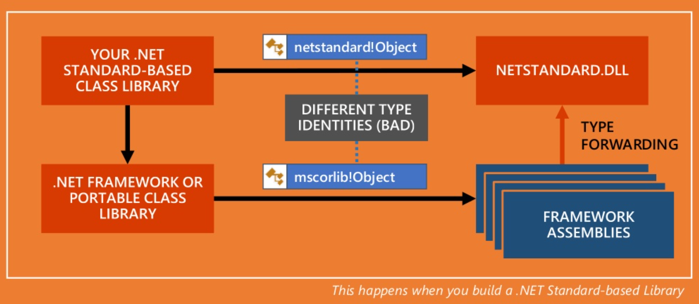
Definitions
https://www.slideshare.net/terrajobst/net-standard-under-the-hood
Notes:
When you build a library, you’re targeting “netstandard.dll”. This has no implementation (load it in ILSpy if you’re curious to see “throw null;”). If you reference libraries that something other than .NET Standard libraries, this is allowed, as the definitions forward to netstandard.dll (be careful with this, if that library uses things like the registry, it will not work when you run it in .NET Core).
Side note, this is why you should no longer assume where “common” types, like System.Object, reside.

Slide 20
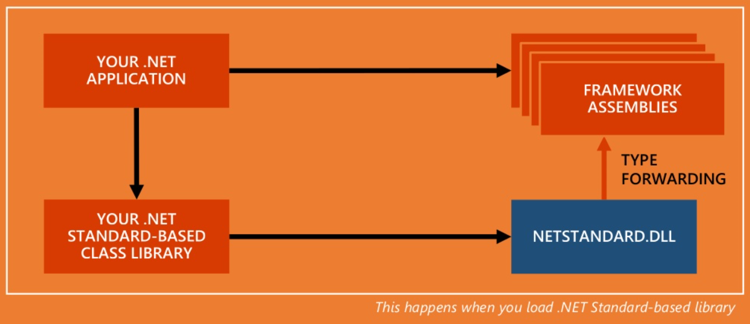
Definitions
https://www.slideshare.net/terrajobst/net-standard-under-the-hood
Notes:
When you run your application, things work in “reverse”. The NS library you’re referring to now forwards definitions to the platform that’s executing.

Slide 21
Recommendations
Use tools to navigate .NET Standard
.NET Portability Analyzer - https://github.com/Microsoft/dotnet-apiport
.NET API Catalog - https://apisof.net/
APICompat - https://github.com/dotnet/corefx/wiki/ApiCompat
Use .NET Standard as the target for libraries (non-host code). Use .NET Core, .NET Framework, etc. as the target for host-based code.
Use DI to inject platform-specific implementations to .NET Standard code.
Notes:
Here are some recommendations when .NET Standard becomes a part of your dev experience.

Slide 22
Demo: .NET Standard Tools and Setup
Understanding .NET Standard
Notes:
Let’s take a look at some of the tools and how you can set things up in a project.

Slide 23
Understanding .NET Standard
Jason Bock
Remember…
https://github.com/JasonBock/Presentations/blob/master/Understanding%20.NET%20Standard.pptx
https://github.com/JasonBock/UnderstandingNETStandard
References in the notes on this slide
Notes:
References:
* .NET Standard Explained: How To Share Code - https://stackify.com/net-standard-explained/
* .NET Standard 2.0 vs .NET Core 2.0 - https://github.com/dotnet/standard/blob/master/docs/comparisons/netstandard2.0_vs_netcoreapp2.0/README.md - note from Immo, "It's a diff, so: + It's in Core, not Standard, - It's in Standard, not Core"
* .NET Standard - Demystifying .NET Core and .NET Standard - https://msdn.microsoft.com/en-us/magazine/mt842506.aspx
* What is the difference between .NET Core and .NET Standard Class Library project types? - https://stackoverflow.com/questions/42939454/what-is-the-difference-between-net-core-and-net-standard-class-library-project
* 5 .NET Standard Features You Shouldn’t Miss - https://developer.telerik.com/topics/net/5-net-standard-features-shouldnt-miss/
* Øredev 2017 - Kathleen Dollard - .NET Standard: The Easy Route to Platform Independence - https://vimeo.com/243225570
* .NET Standard FAQ - https://github.com/dotnet/standard/blob/master/docs/faq.md
* .NET Standard - https://docs.microsoft.com/en-us/dotnet/standard/net-standard
* Package-based Frameworks - https://docs.microsoft.com/en-us/dotnet/core/packages#package-based-frameworks
* Immo Landwerth's .NET Standard Videos - https://www.youtube.com/watch?v=YI4MurjfMn8&list=PLRAdsfhKI4OWx321A_pr-7HhRNk7wOLLY
* .NET Standard 2.0 Demo - https://www.youtube.com/watch?v=gNUUAIGHupc
* .NET Standard - What's new in 2.0 - https://www.youtube.com/watch?v=fOzcVwzkGP0
* .NET Standard - Introduction - https://www.youtube.com/watch?v=YI4MurjfMn8
* .NET Standard - Checking Compatibilty - https://www.youtube.com/watch?v=rzs_FGPyAlY
* .NET Standard - Under the Hood - https://www.youtube.com/watch?v=vg6nR7hS2lI&t=1s
* .NET Standard - .NET Core and Timelines - https://www.youtube.com/watch?v=1UxTaaAWtio
* .NET Standard - 2.0 Preview - https://www.youtube.com/watch?v=HyfDG4mjBPk
* .NET Standard - NuGet Analysis - https://www.youtube.com/watch?v=iIlQer4LEac
* .NET Standard - Introduction - https://www.slideshare.net/terrajobst/net-standard-introduction
* Share More Code with .NET Standard 2.0 - https://blog.xamarin.com/share-code-net-standard-2-0/
* .NET Standard Deep Dive - https://channel9.msdn.com/Shows/On-NET/NET-Standard-Deep-Dive
* FiddlerCore for .NET Standard and Fiddler Orchestra—the Future of Fiddler - http://www.telerik.com/blogs/fiddlercore-for-net-standard-and-fiddler-orchestra-the-future-of-fiddler
* What is .NET Standard? - http://adamralph.com/netstandard-deck/

